Slide 1
Creative Summer 2023 Workshops at Harlington Hospice
Dates: Various dates in August
Free to attend
Summer workshops will take place at:
Lansdowne House, Harlington Hospice, St Peters Way. UB35AB
Tel: 0208759 0453

Slide 2
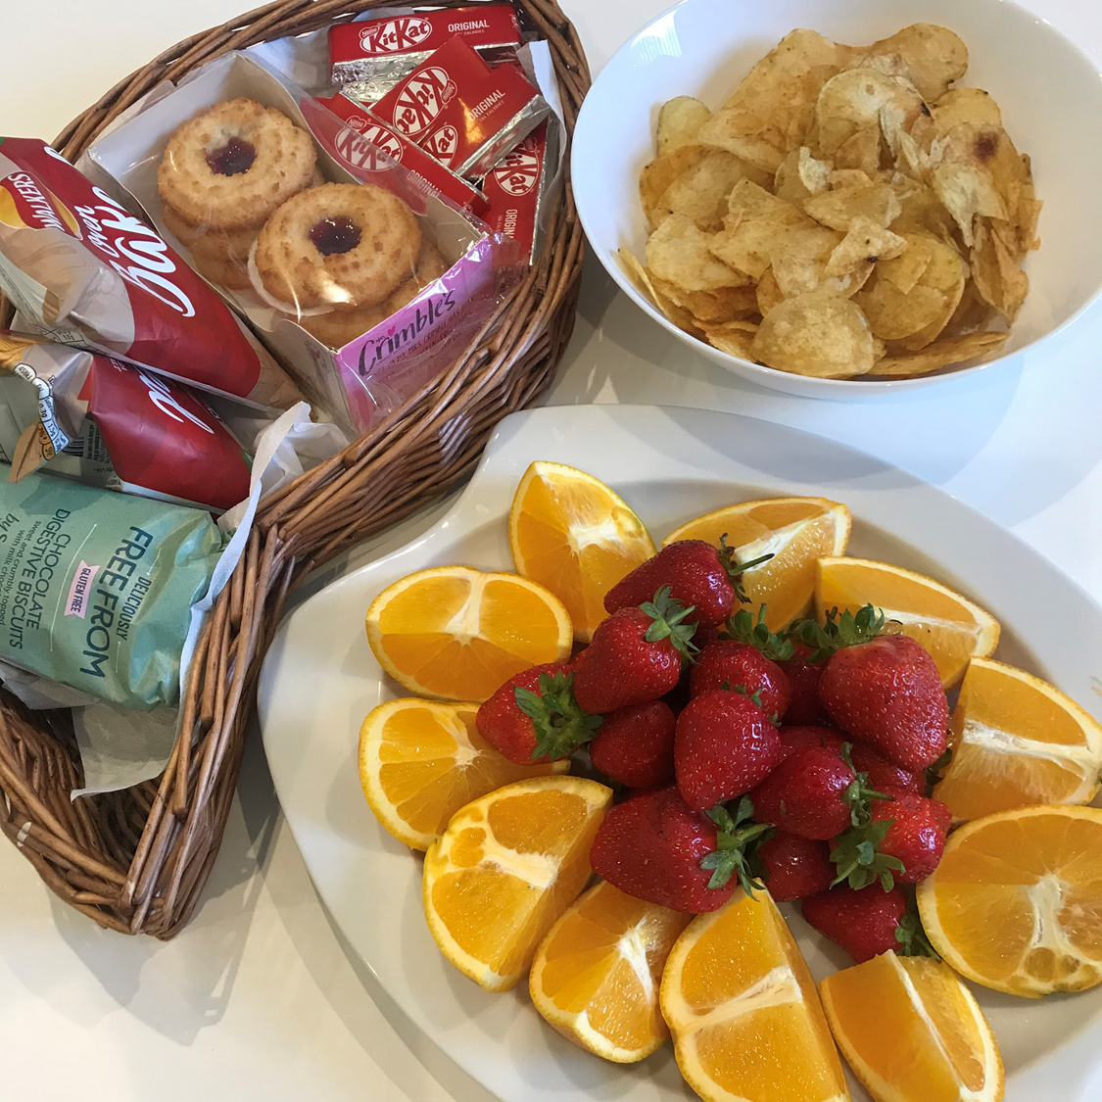
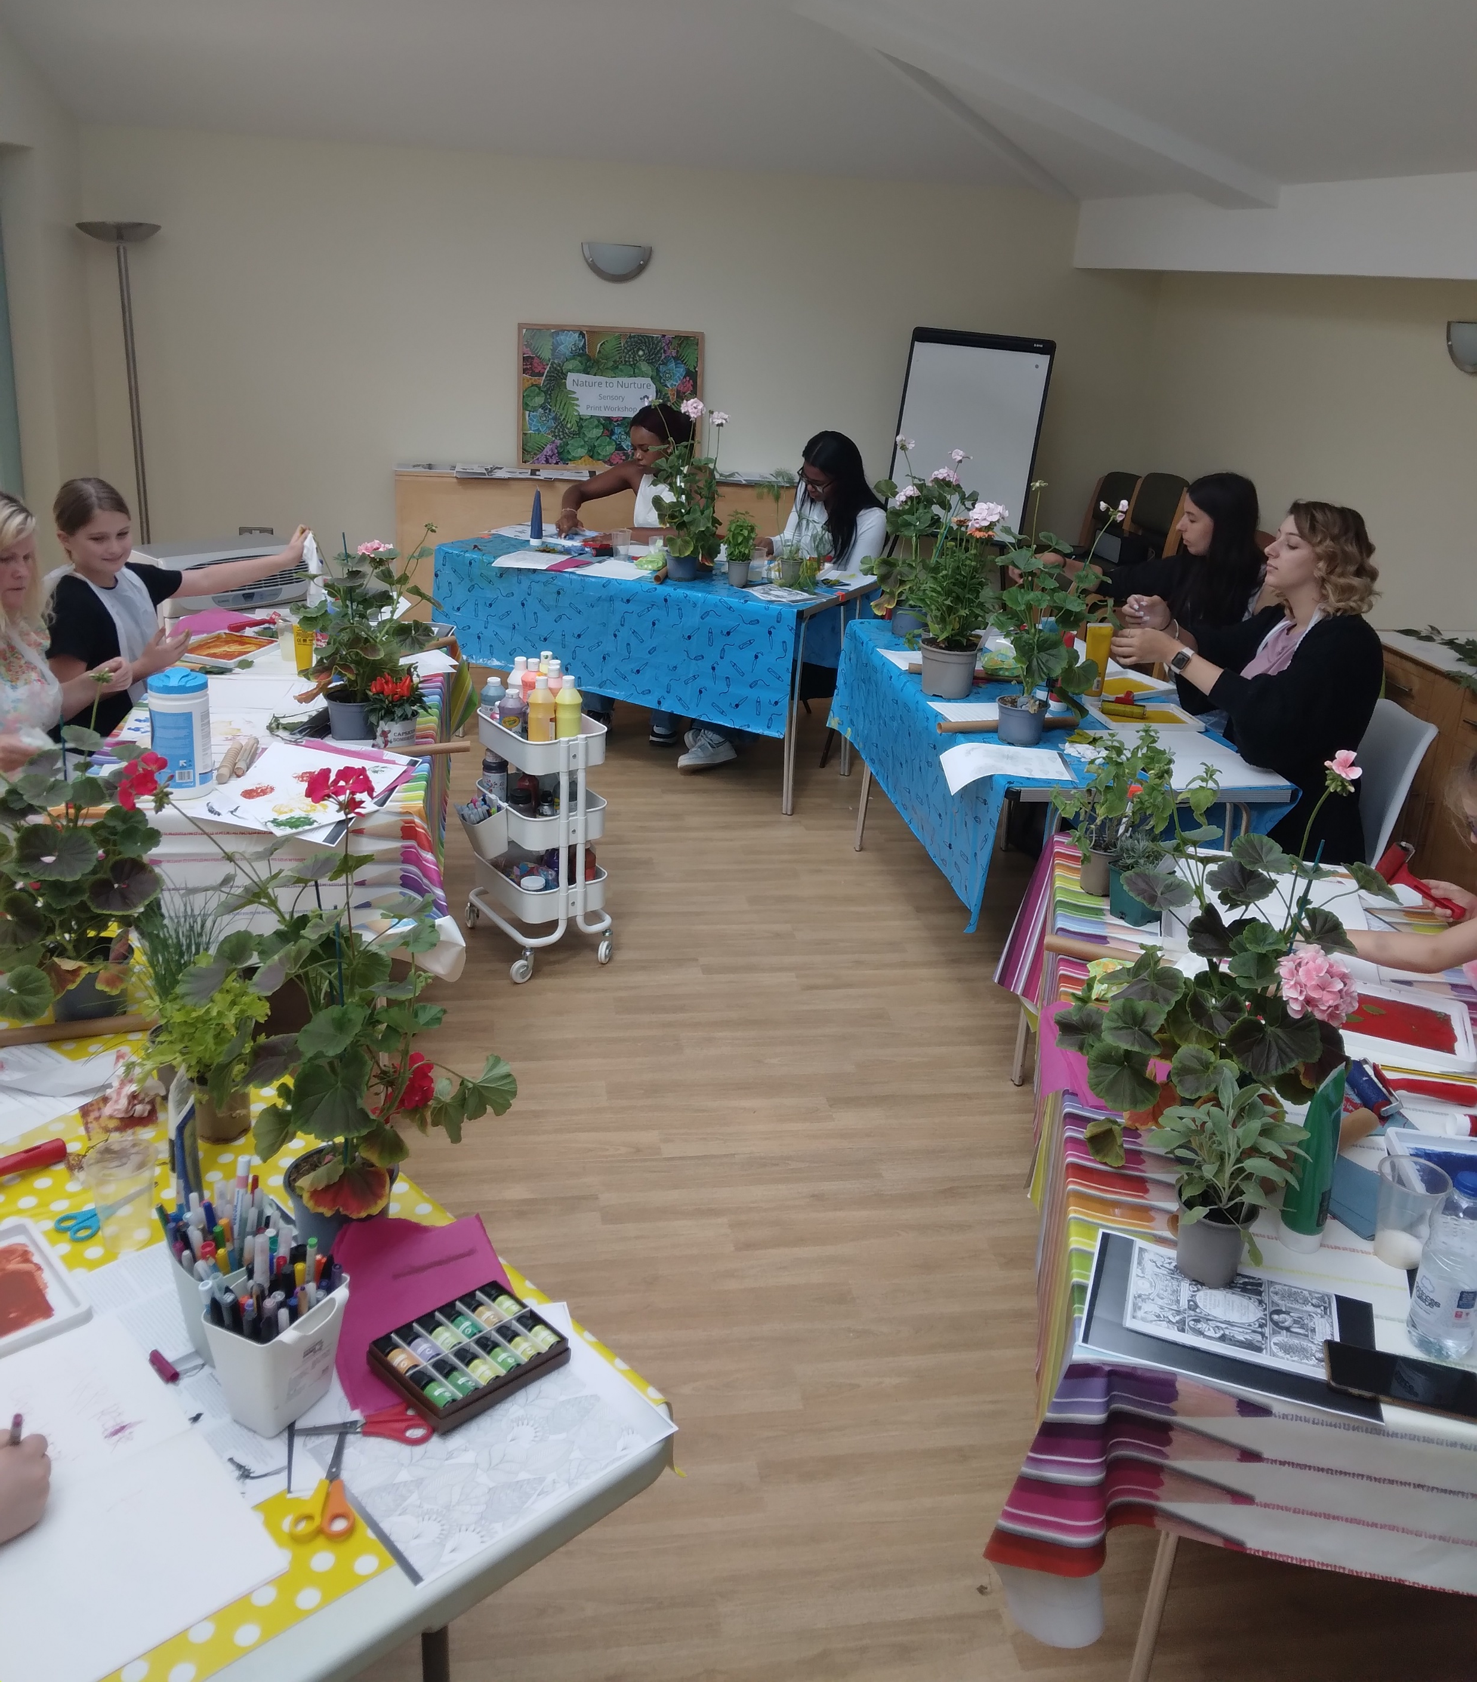
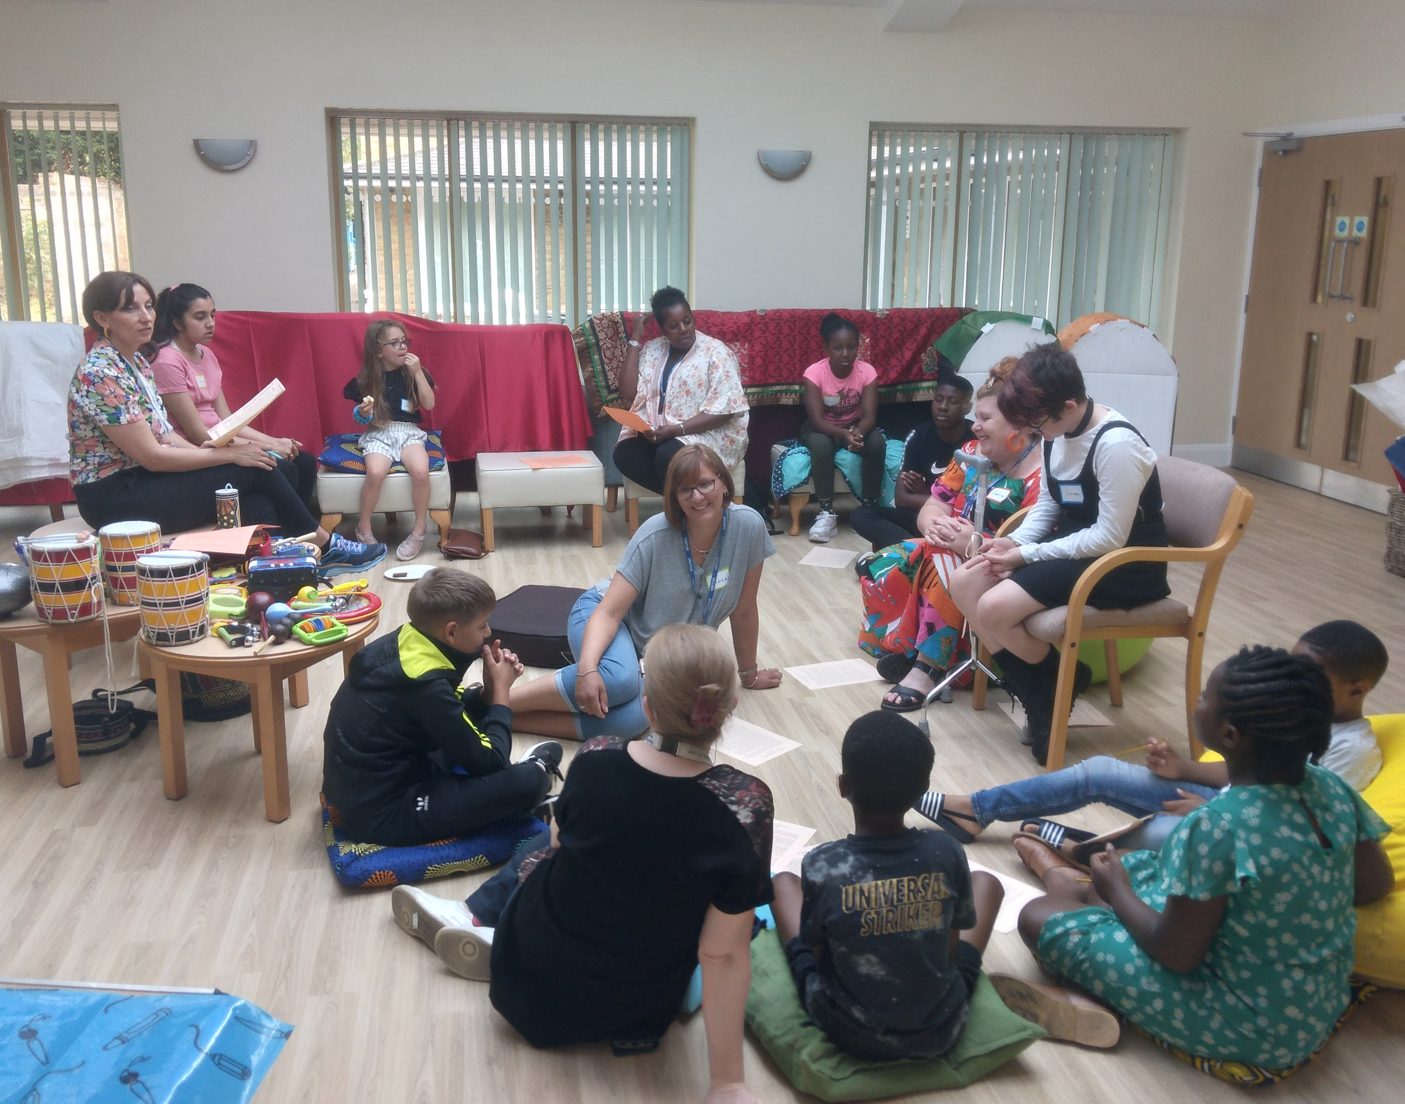
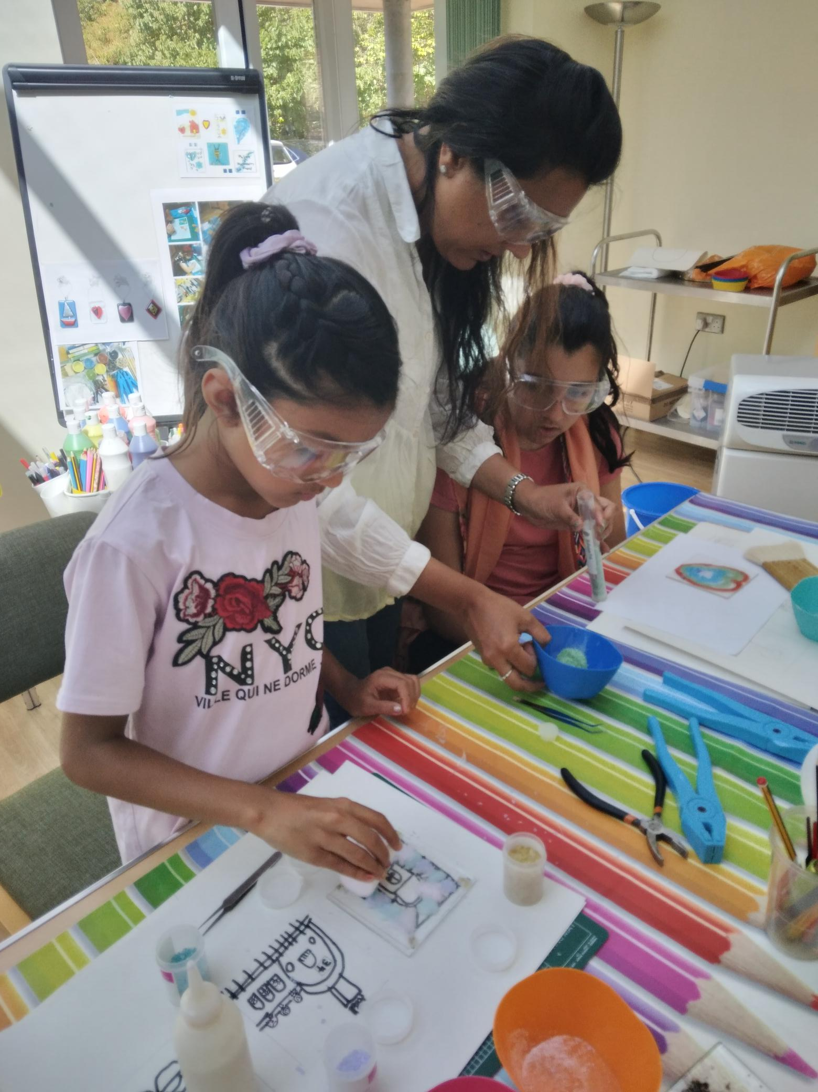
You are invited to attend the CABS Creative Summer Workshops at Harlington Hospice
Spaces are limited to 12 members per workshop and will be on a first applied basis. Parent/Carers are welcome to attend also and the workshops are free of charge.
There will be light refreshments and a selection of snacks & fruit during the break of the workshop (please let us know of any allergies).
Using glues and paints can get a bit messy so best not to wear good clothes ☺
Art work can be taken home at the end of the workshop with the exception of the glass making workshop, as glass will be fired and returned at a later date.

Slide 3
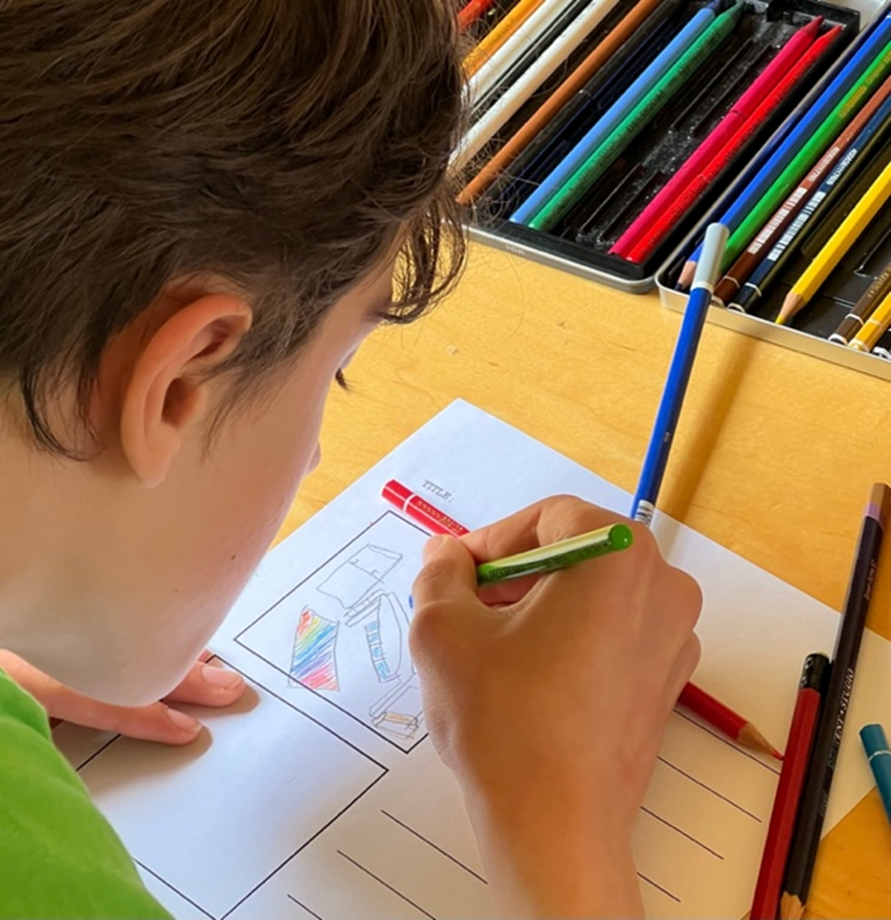
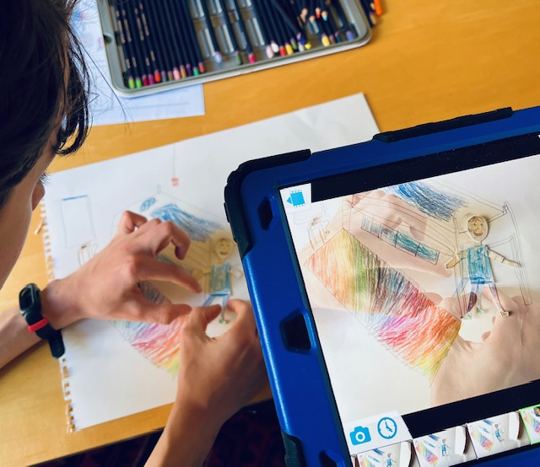
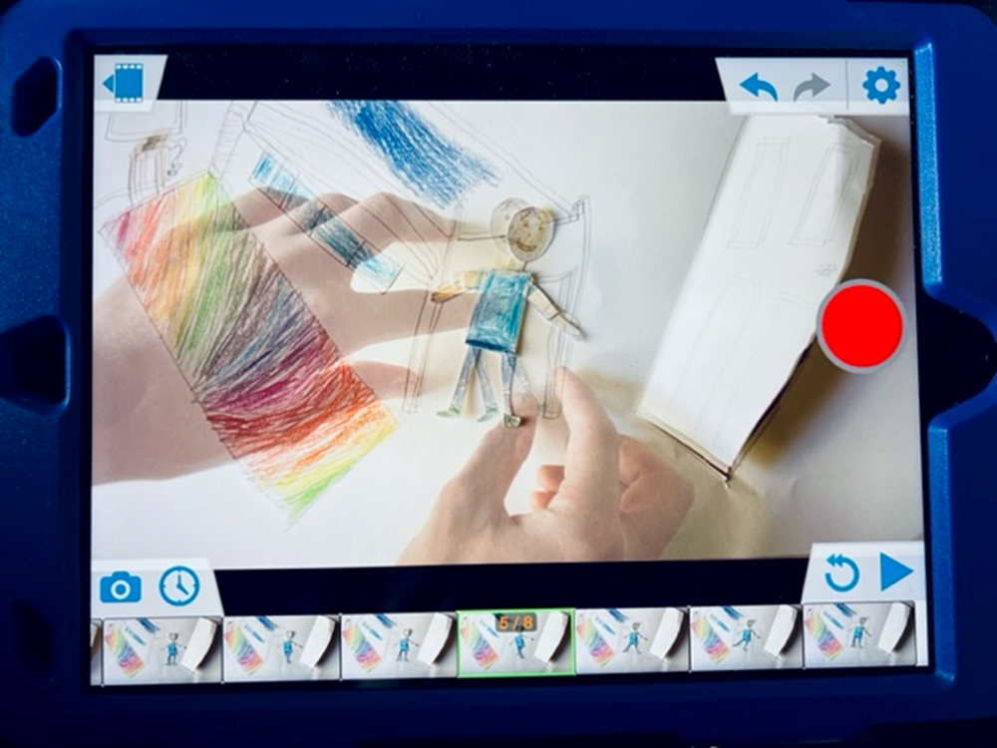
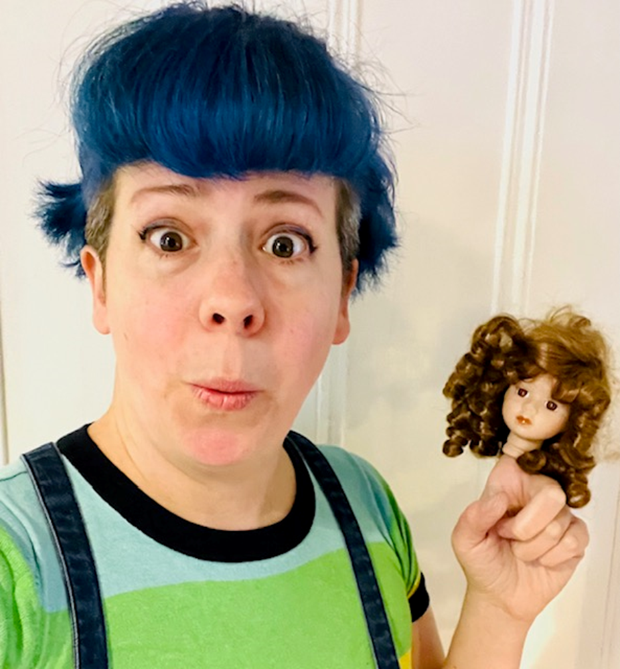
3 Day Animation Workshop with film-maker Sarah
We are excited to introduce a new animation in the summer workshops 2023 – places are limited so please book in advance to avoid disappointment!
On day 1 themes are shared and developed as a group, before working on our own ideas. Next it’s time to draw simple storyboards to plan the action and what we need to make. In the afternoon you will get arty - with making backgrounds and special cardboard cut-out puppets, ready for filming.
Day 2 is the filming day. In small groups or pairs, you will be animating your puppets using iPads and easy software and maybe even be able to animate a title and credits.
Day 3 On our final session together we can record a little audio to make your film have that extra personal touch.

Slide 4
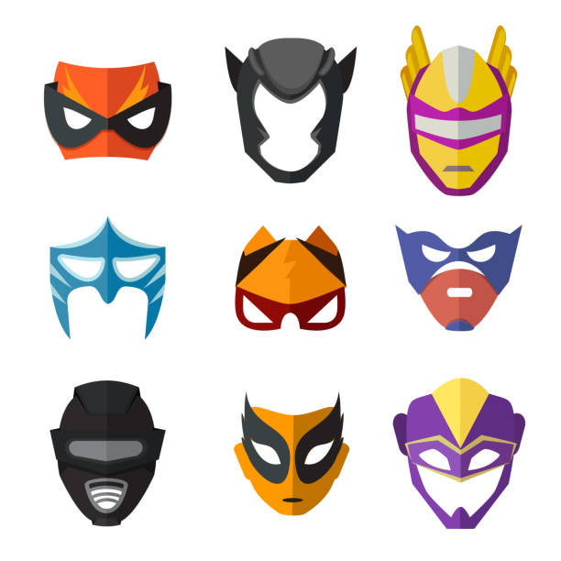
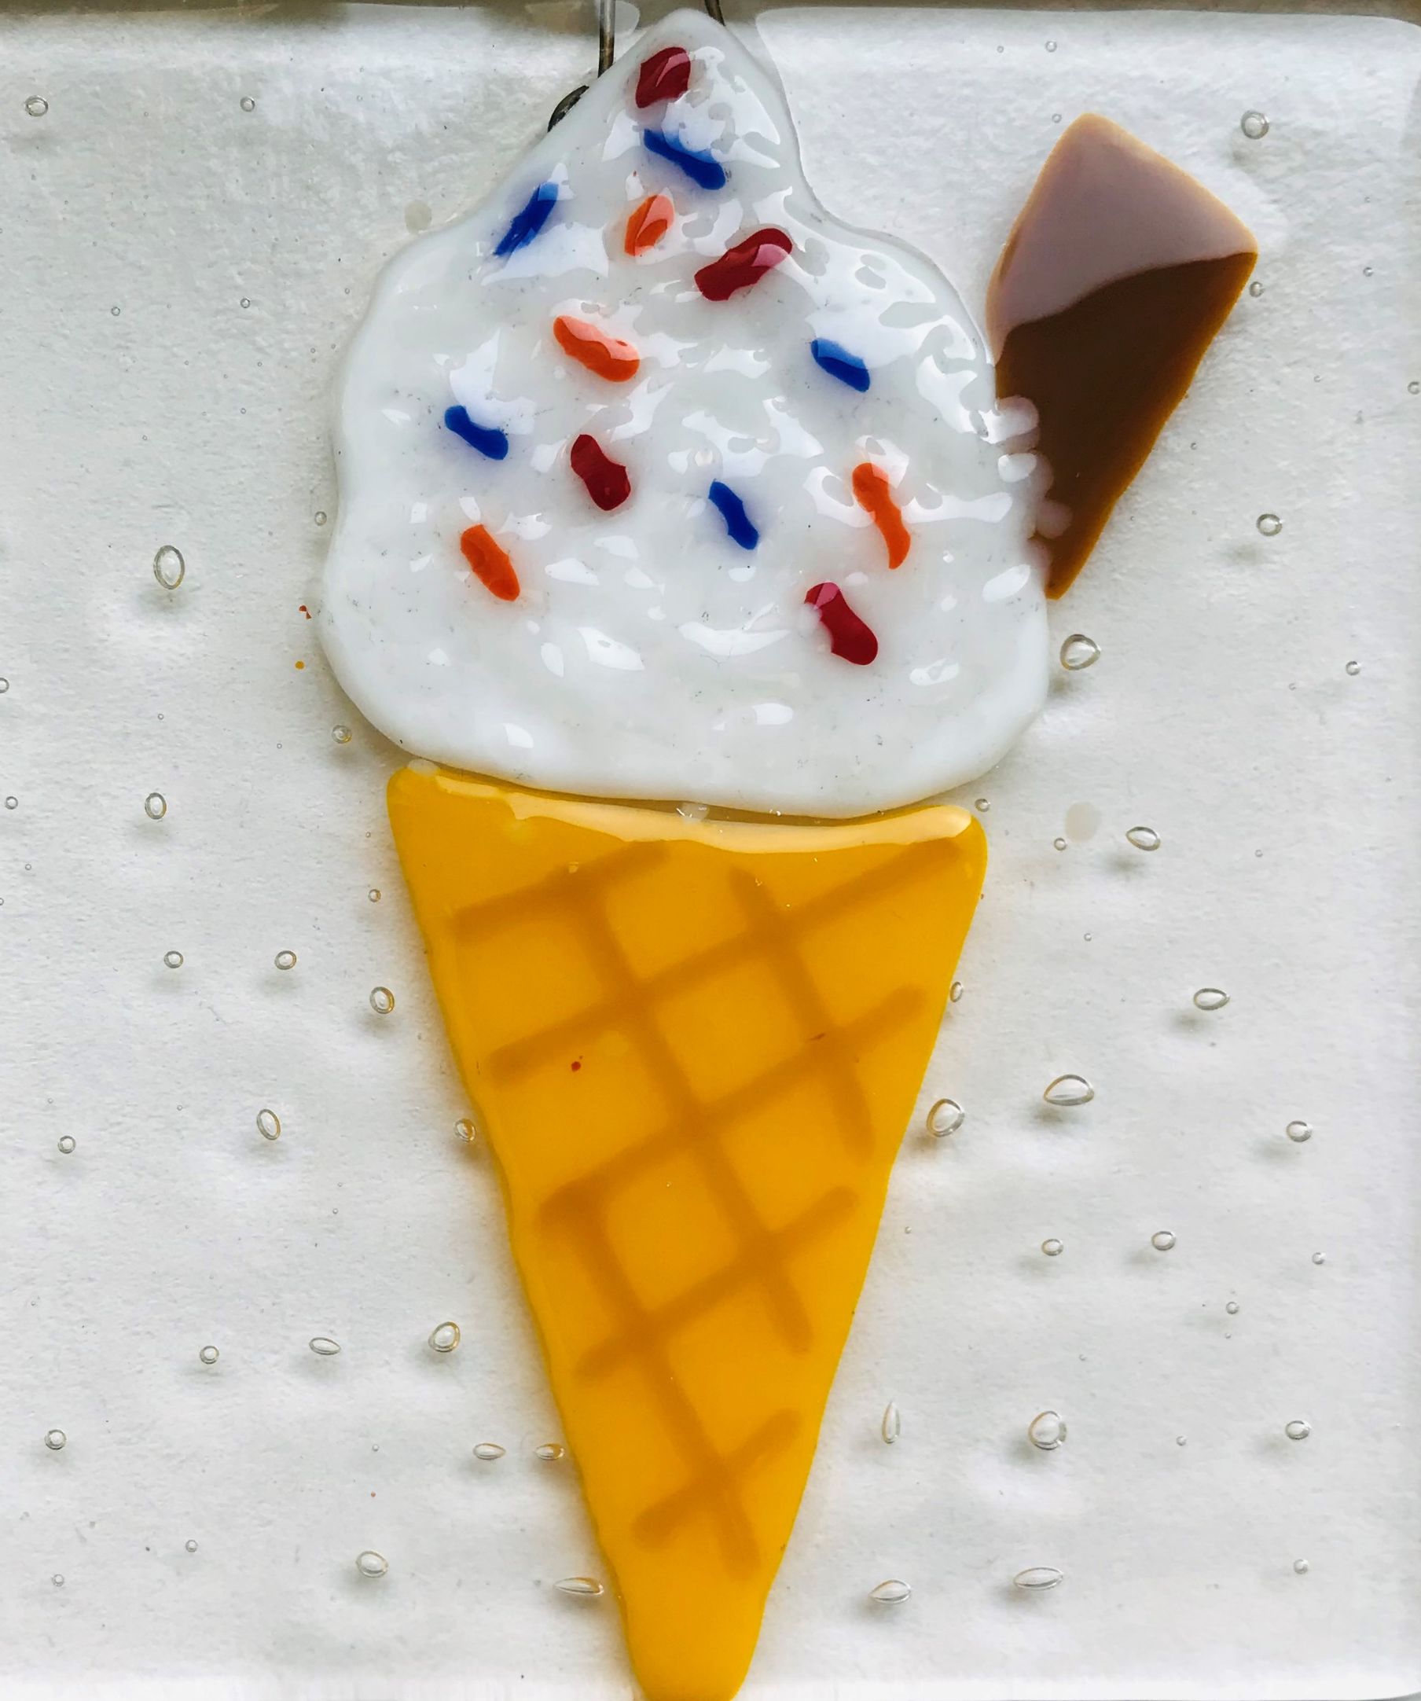
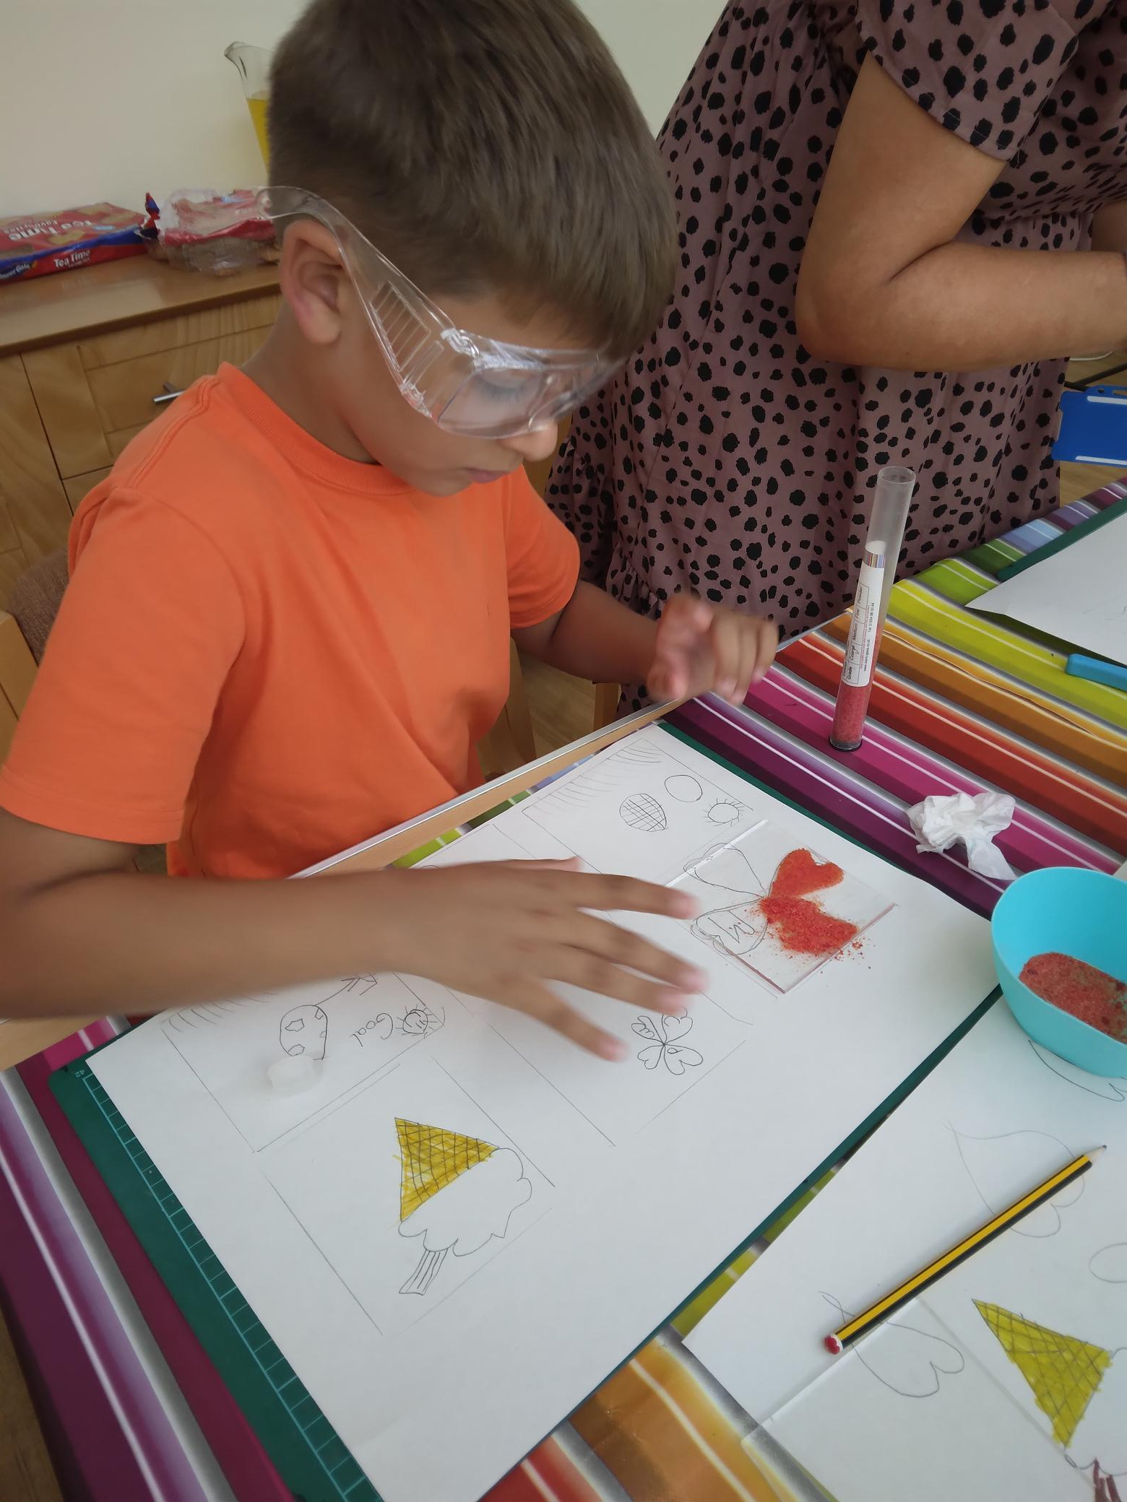
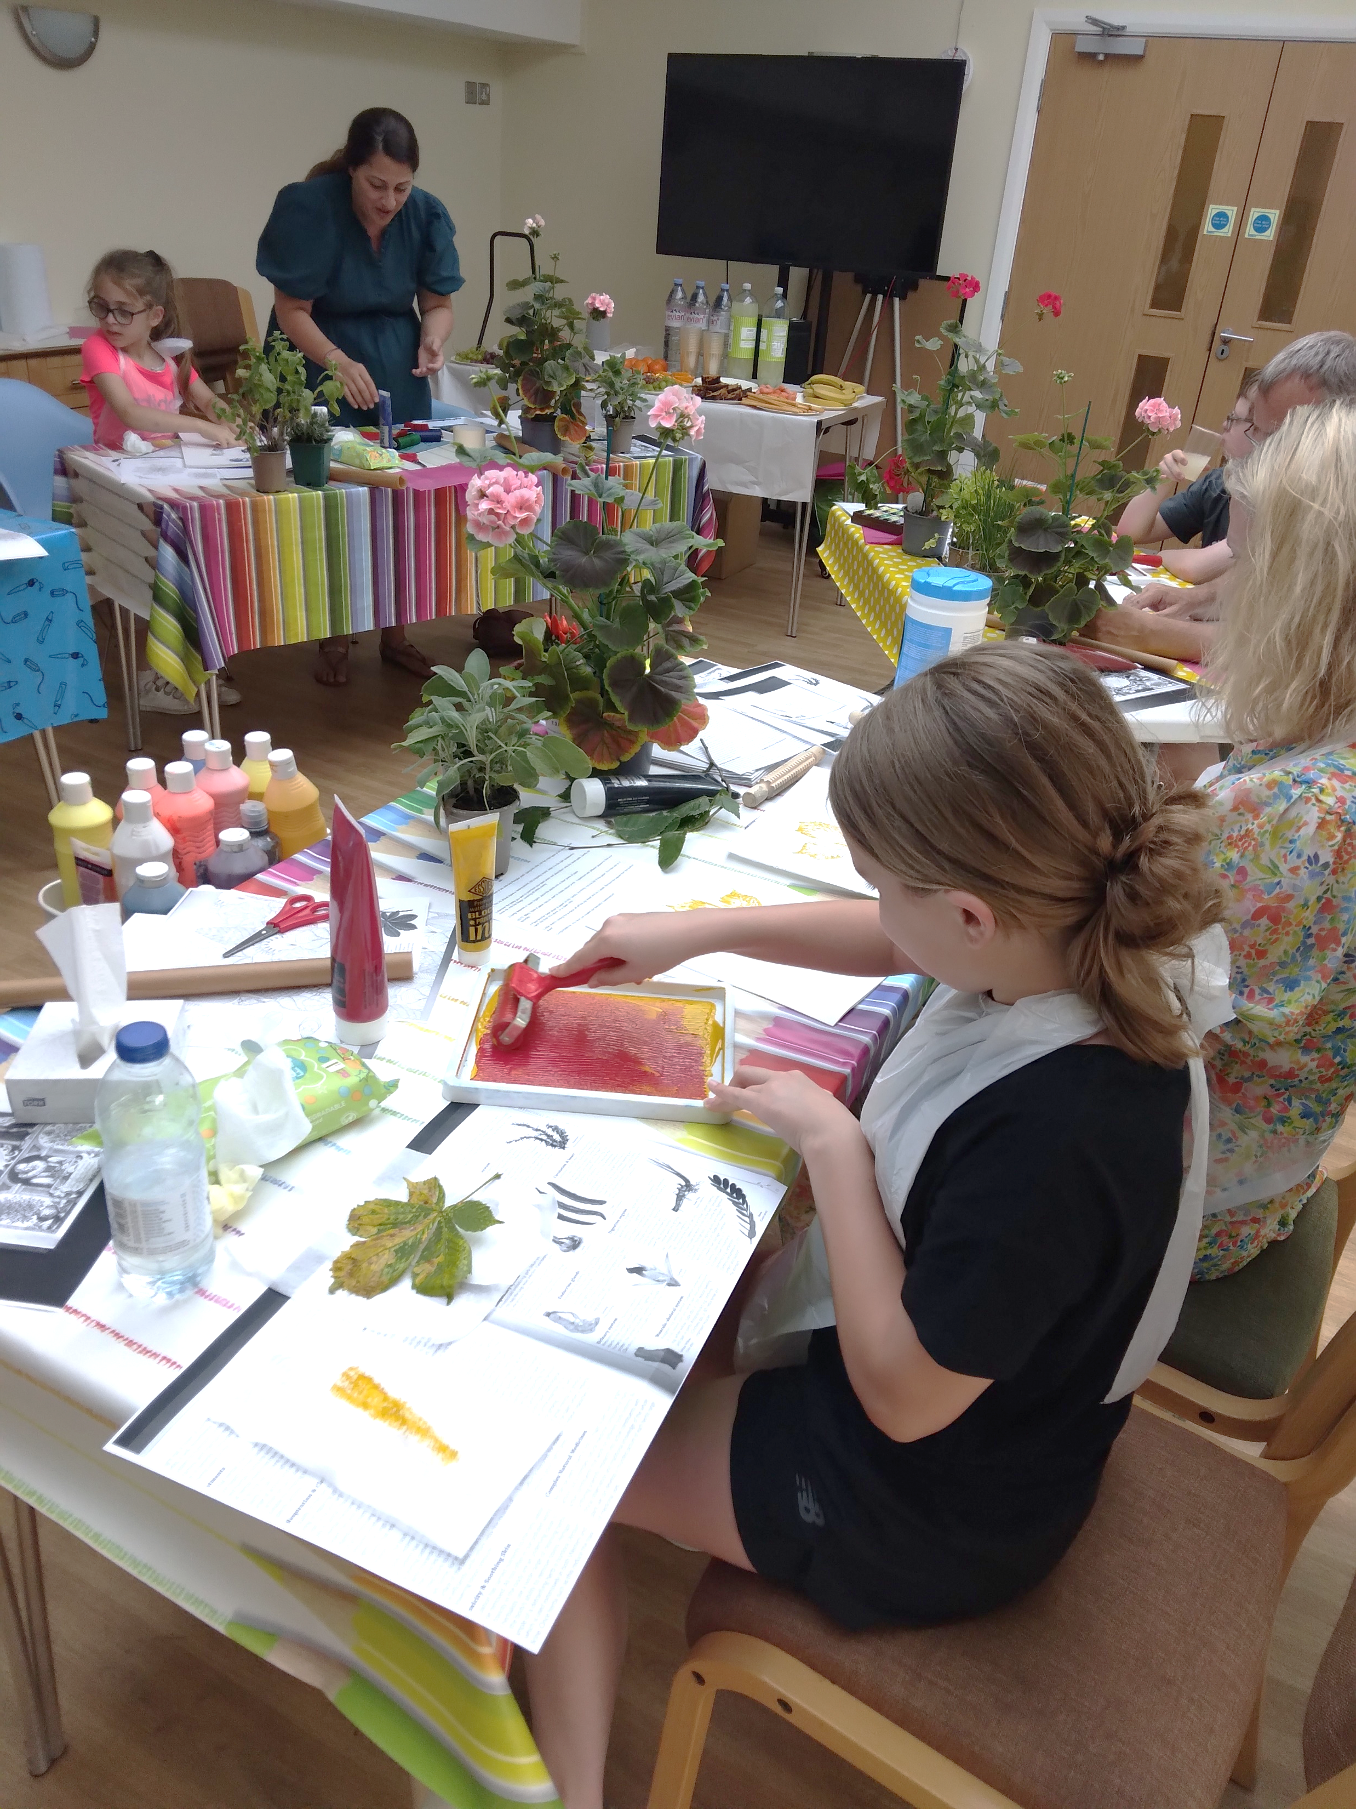
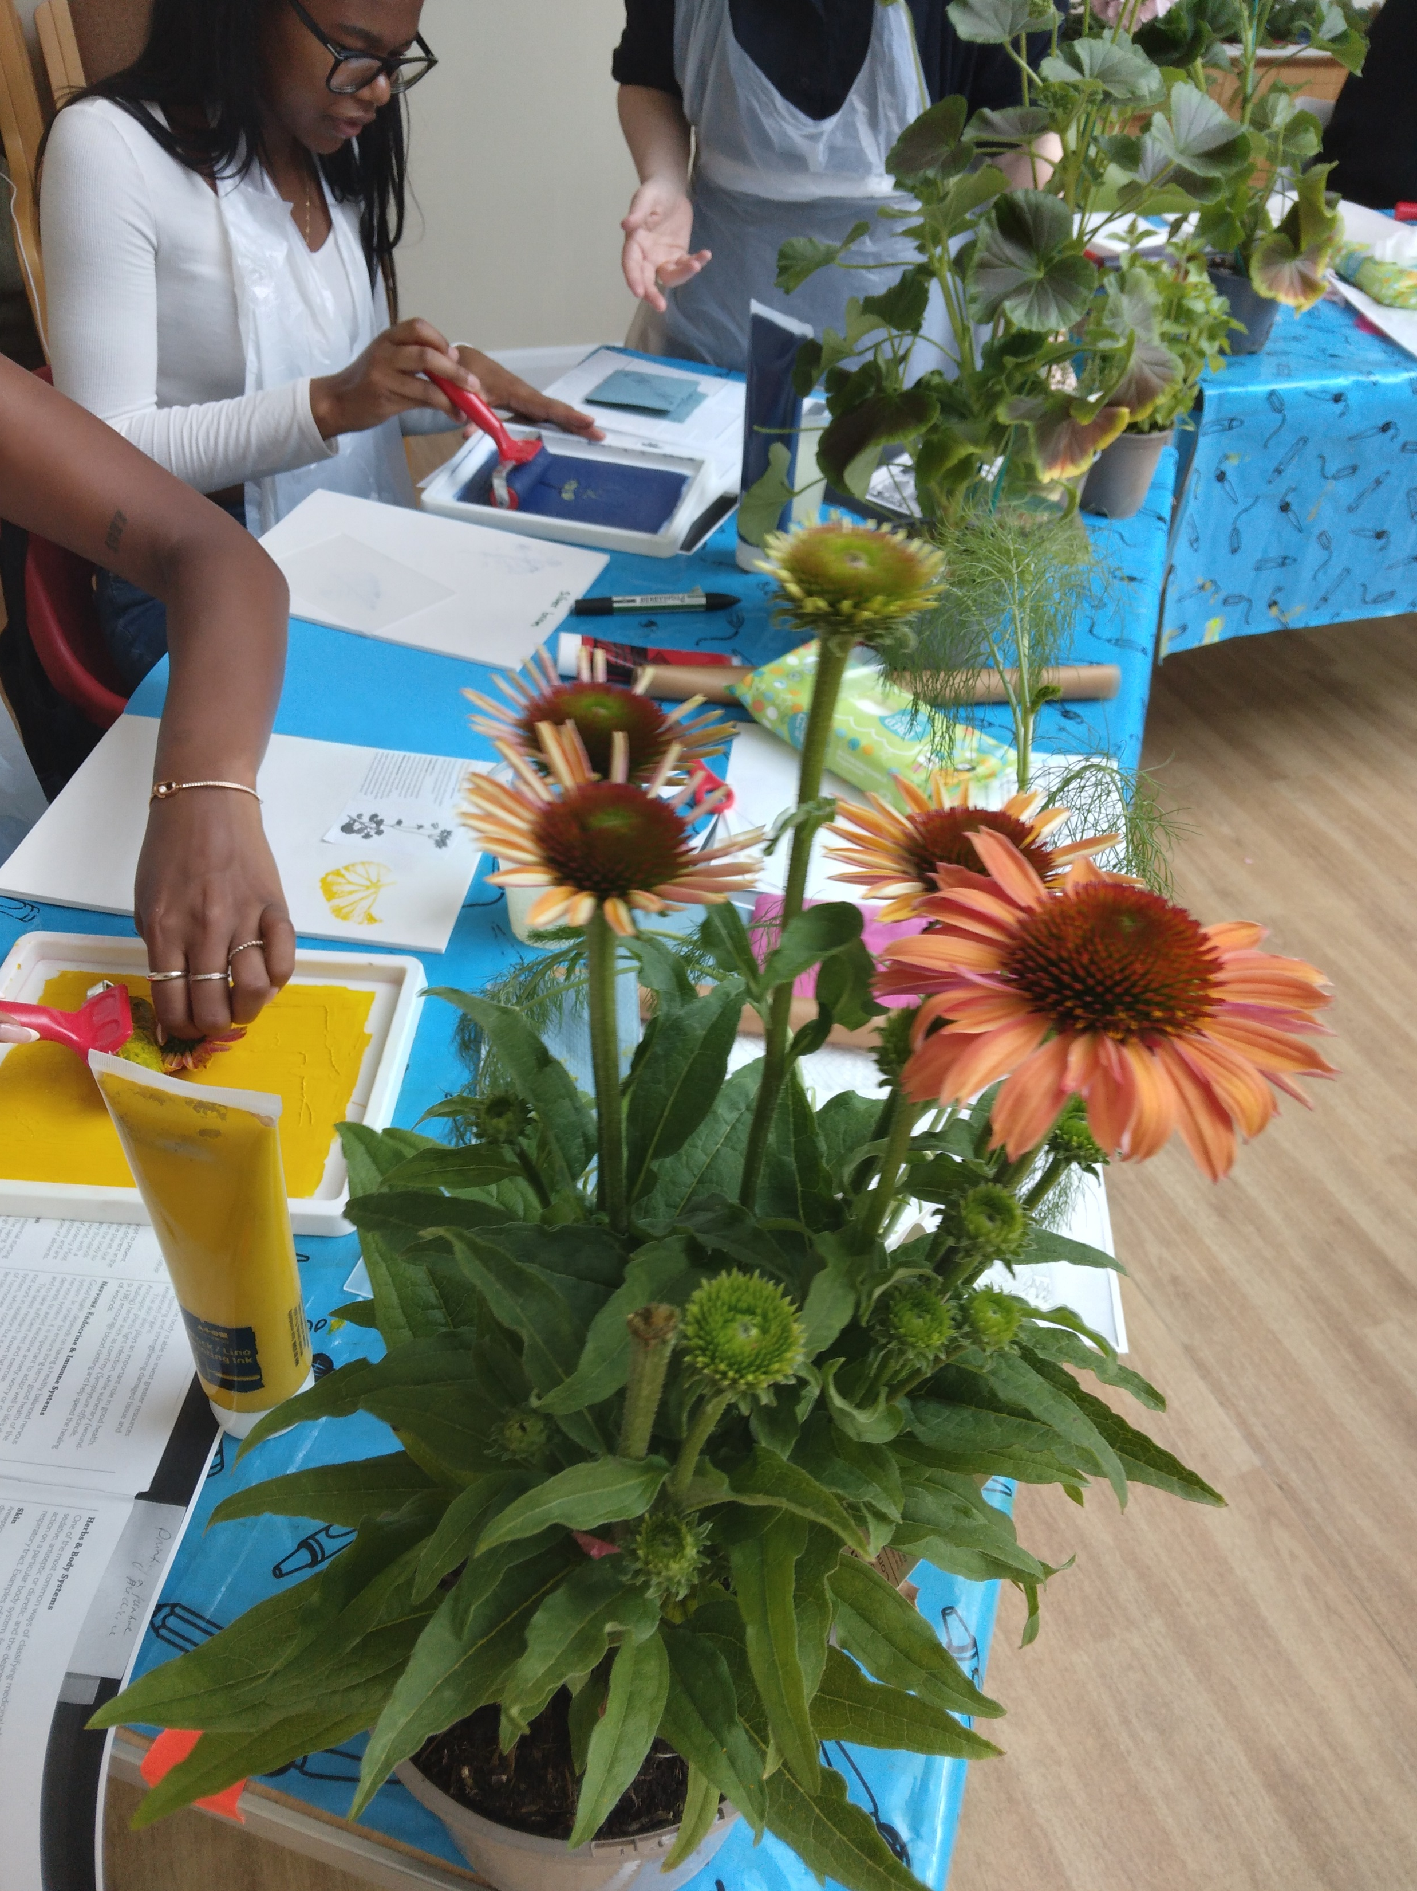
Superhero Workshop with Magda & Pasha
Glass memory workshop with Paula
Print-making Workshop with Nana
“We can be Heroes, just for one day, We can be us, just for one day.” David Bowie
Come and join us for a workshop where you can become a Superhero of your own making just for one day! During the workshop we will be designing superhero masks/costumes, superpower tools and then go together on a superhero adventure/quest…
No previous experience of art or drama needed!
You will be supported by the art therapist to create your own special piece of art work.
There will be a selection of materials to choose from such as; painting with enamels, frits and powders to make patterns and string materials can make words. Glass will be pre-cut into squares and everyone can make their own design.
No previous experience of glass-making required to enjoy and create a unique piece of glass!
Inspired by herbal plants, this nature printing workshop will take impressions from fresh plants with oil-based inks on paper, the sessions would also be an exploration of mark-making with diverse leaf shapes and textures.
No previous experience of print-making required to enjoy this workshop!

Slide 5
Date | Workshop Time | Activity | Please add preference 1-4 (1 = most like to attend)
3rd August | Morning: 10.30 - 12.30 | Nature to Nurture Printmaking Workshop with Nana Zhvitiashvili Ages 7 - 10
3rd August | Afternoon: 14:00 - 16:30 | Nature to Nurture Printmaking Workshop with Nana Zhvitiashvili Ages 11 +
7th August | 10:30 – 15:00 | Bring your ideas to life animation workshop Ages 7+
8th August | 10:30 – 15:00 | Bring your ideas to life animation workshop Ages 7+
9th August | 10:30 – 15:00 | Bring your ideas to life animation workshop Ages 7+
14th August | Morning: 10.30 - 12.30 Afternoon: 14:00 - 16:30 | Superhero Workshop with Magda Florek and Pasha Wild Ages 5+
23rd August | Morning: 10.30 - 12.30 Afternoon: 14:00 - 16:30 | Memory making glass infusing workshop with Paula Boyle Ages 8+

Slide 6
Take a picture on your phone or email of the completed form and send to cabsreferrals@harlingtonhospice.org
Please choose as desired and return by Thursday 20th July 2023.
If you are unable to attend, we would appreciate it if you could let us know at least one week in advance to give others an opportunity to attend.
You can also telephone: 02087590453 to book your place on a workshop.

